Slide 1
Particle Physics Event Classification
Saurabh Pende

Slide 2
Outline
Introduction
Dataset Overview
Exploration and Visualizations
Data Preprocessing
Model Selection and Model Training.
Model Evaluation
Conclusion

Slide 3
Introduction

Slide 4
Backstory
Particle accelerators : . Particle accelerators enable physicists to explore the fundamental nature of matter by observing subatomic particles produced by high-energy collisions of particle beams.
Higgs Boson : The Higgs boson particle,also called the God Particle in Mainstream media,is the final ingredient of the standard model of particle physics,which sets the rules for subatomic particle and forces.
The Discovery : On 4th July 2012, the ATLAS and CMS experiments at CERN's Large Hadron Collider announced that both of them had observed a new particle in the mass region around 125 GeV. This particle is consistent with the theorized Higgs boson. This experimental confirmation earned François Englert and Peter Higgs The Nobel Prize in Physics 2013

Slide 5
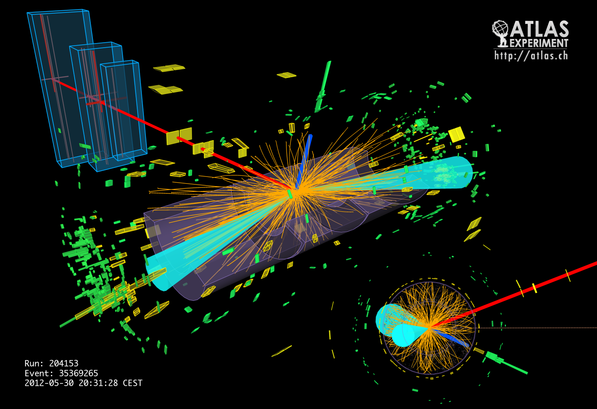
The first evidence of decays was recently reported, based on the full set of proton–proton collision data recorded by the ATLAS experiment at the LHC during 2011-2012.Despite the consistency of the data with decays, it could not be ensured that the statistical power exceeds the threshold, which is the required standard for claims of discovery in high-energy physics community.

Slide 6
Problem Statement
IN THE FIELD OF PARTICLE PHYSICS, ACCURATE IDENTIFICATION AND CLASSIFICATION OF EVENTS ARE CRUCIAL FOR UNDERSTANDING FUNDAMENTAL PARTICLES AND THEIR INTERACTIONS. THE PROVIDED DATASET CONTAINS VARIOUS FEATURES DERIVED FROM PARTICLE PHYSICS EXPERIMENTS, AND THE GOAL IS TO BUILD A MACHINE-LEARNING MODEL TO CLASSIFY EVENTS INTO SIGNAL (s) AND BACKGROUND (b) CATEGORIES. THIS CLASSIFICATION AIDS IN DISTINGUISHING EVENTS OF INTEREST (SIGNAL) FROM BACKGROUND NOISE.

Slide 7
Objective/Goal
The primary goal of this machine learning project is to develop a model that can accurately predict whether a given set of experimental features corresponds to a signal or background event. Successful classification contributes to the advancement of particle physics research by automating the identification of events that may indicate the presence of specific particles or phenomena.

Slide 8
Why It’s important to Solve?
Particle accelerators enable physicists to explore the fundamental nature of matter by observing subatomic particles produced by high-energy collisions of particle beams. The experimental measurements from these collisions inevitably lack precision, which is where machine learning (ML) comes into picture. The research community typically relies on standardized machine learning software packages for the analysis of the data obtained from such experiments and spends a huge amount of effort towards improving statistical power by extracting features of significance, derived from the raw measurements.

Slide 9
Dataset Overview

Slide 10
Dataset Information
The Dataset respectively contains 250000 observations(rows) and total 33 features(columns).
It has features including 'EventId','DER_mass_MMC','DER_mass_transverse_met_lep',DERmass_vis', 'DER_pt_h', 'DER_deltaeta_jet_jet', 'DER_mass_jet_jet' etc.
Target Variable - Label which is a binary class consist of Values Background and signal.

Slide 11
Basic Data Exploration
Number of Observations : 250000
Number of columns : 33
Number of Integer columns : 2
Number of float columns : 30
Number of Object columns : 1
Number of Duplicate observations : 0
Constant column : None
Number of columns with missing values : 0

Slide 12
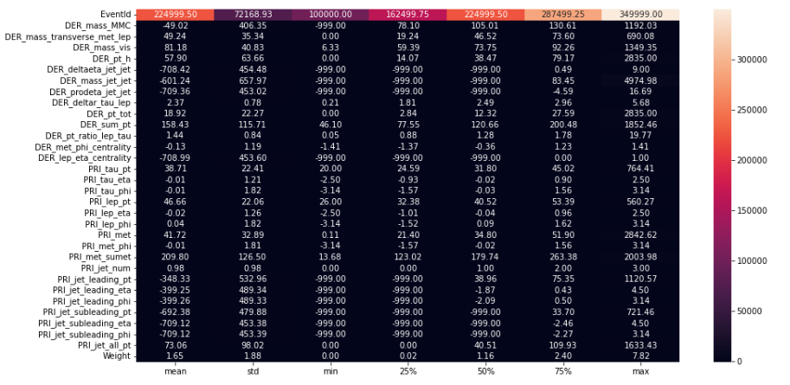
Descriptive Stats

Slide 13
Explorations and Visualization

Slide 14

1.Univariate Analysis
Target Variable : The target Label is a binary variable ,taking values
b and s, indicating the status of an events.

Slide 15
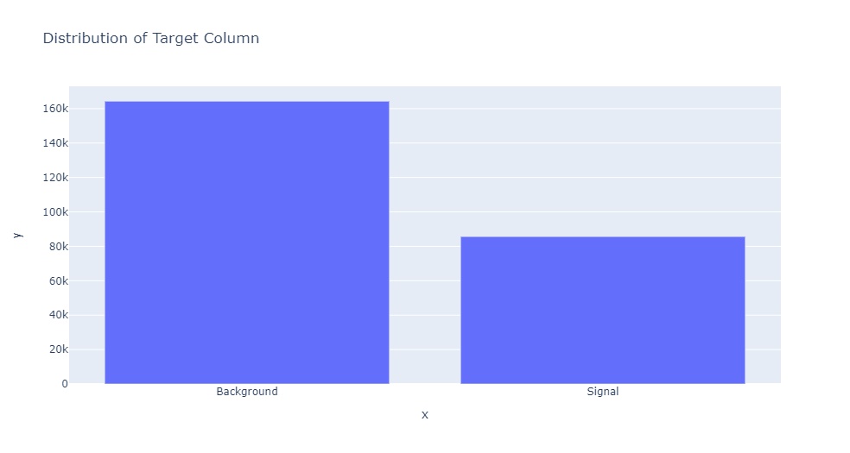
164k observations belongs to Background Class.
86k Observations belongs to Signal Class.

Slide 16
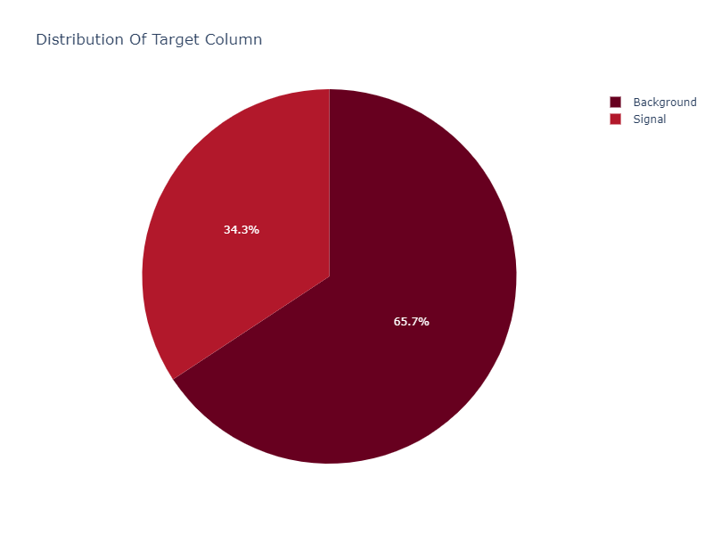
65% observations belong to Background Class.
34% observation belongs to Signal Class.
Notes:
From the observation we can clearly say that our dataset is imbalance.

Slide 17
1.1 Comparison of float feature distributions by target .
We compared the distribution of the float features with Background event and signal event in the data.
If a feature has reasonably different distribution corresponding to the background event and signal event,then it is clear indication that the feature is important in the task of classifying the events when the label is unknown.
Similarly, if a feature has very similar distributions for the two target classes, then it is unlikely to help in the classification problem based on the feature alone.

Slide 18
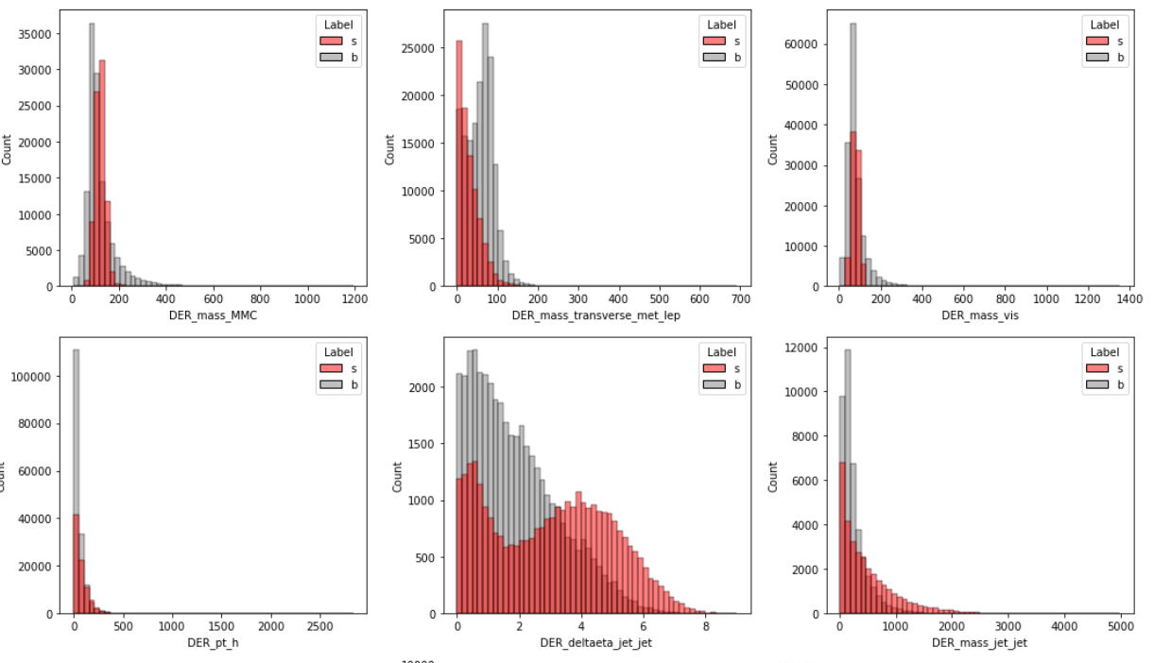

Slide 19
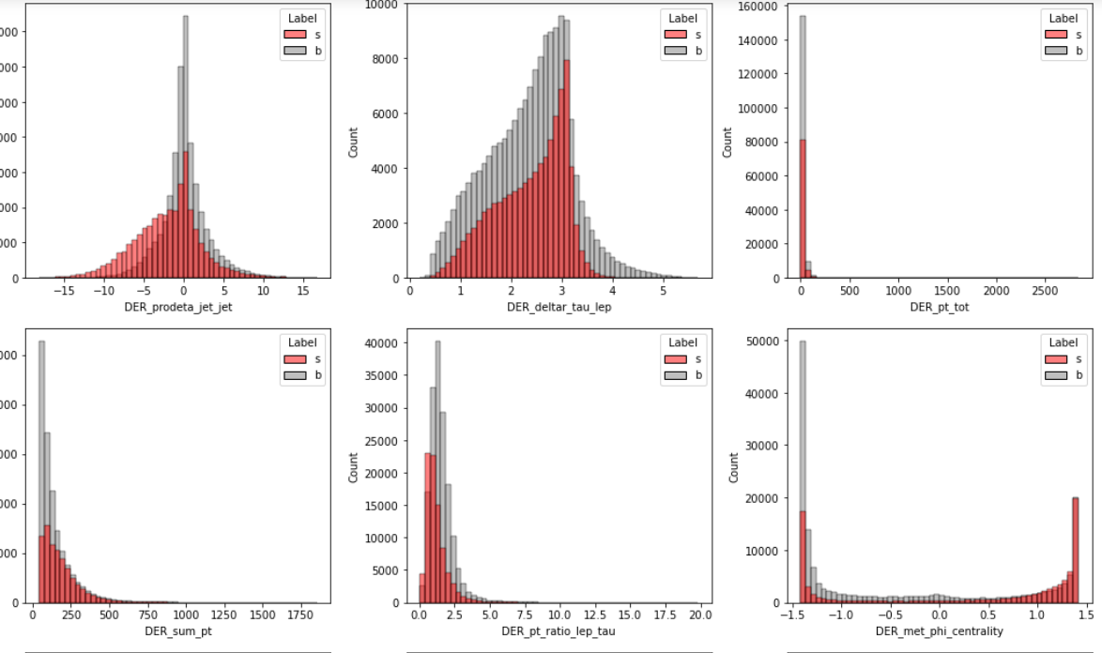

Slide 20
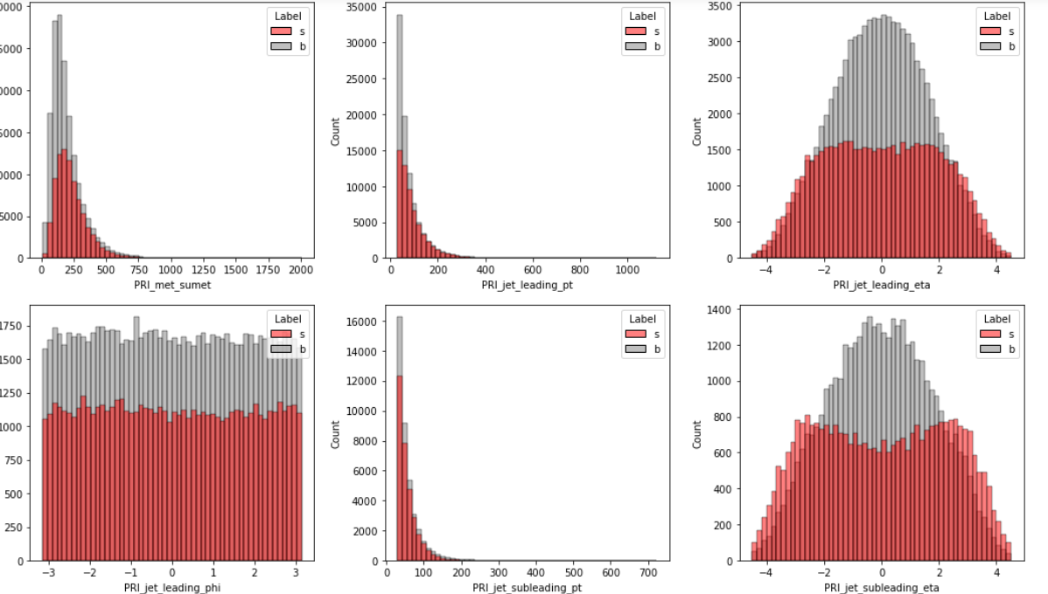

Slide 21
1.2 Skewness
Skewness is a statistical measure that assesses the asymmetry of a probability distribution. It quantifies the extent to which the data is skewed or shifted to one side.
Positive skewness indicates a longer tail on the right side of the distribution, while Negative skewness indicates a longer tail on the left side. Skewness helps in understanding the shape and outliers in a dataset.
We are going to take a look at the skewness of the columns in our data and will try to classify it as extreme skewness,high skewness and moderate skewness.

Slide 22
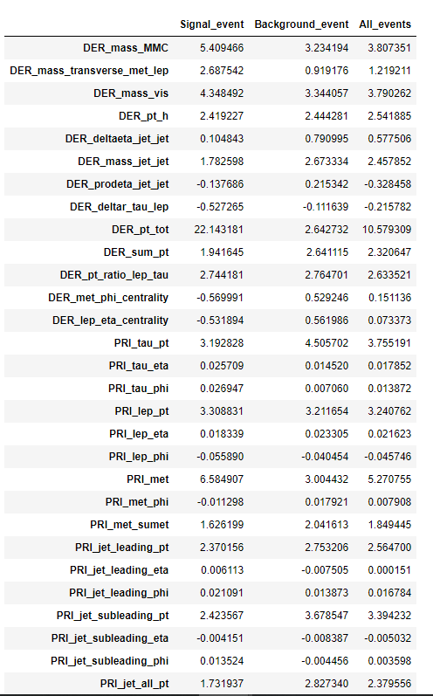
Column with Extreme Positive Skewness : ['DER_mass_MMC', 'DER_mass_vis', 'DER_pt_tot', 'PRI_tau_pt', 'PRI_lep_pt', 'PRI_met', 'PRI_jet_subleading_pt']
Column with High Positive Skewness : ['DER_mass_transverse_met_lep', 'DER_pt_h', 'DER_mass_jet_jet', 'DER_sum_pt', 'DER_pt_ratio_lep_tau', 'PRI_met_sumet', 'PRI_jet_leading_pt', 'PRI_jet_all_pt']
Column with Moderate Positive Skewness : ['DER_deltaeta_jet_jet', 'Weight']

Slide 23
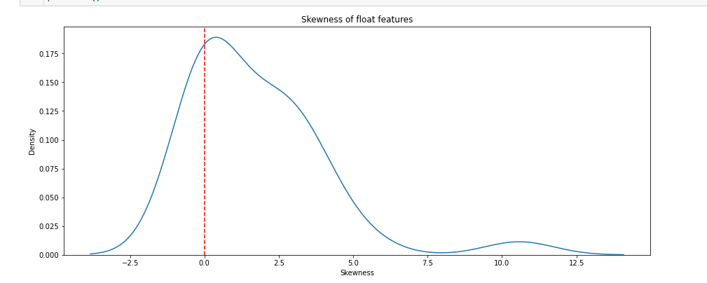
Observation -
The global peak of all event distribution is near zero.
There is a mild peak far towards the right around 11 which indicates there are some float features in the dataset exhibit extremely high positive skewness.

Slide 24
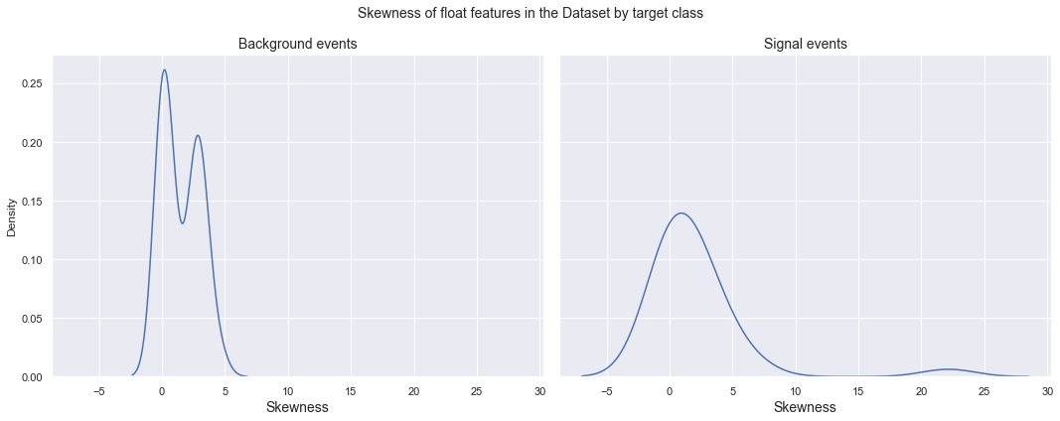
Observation -
The skewness distribution of both background and Signal event have global peak near 0.
There is a mild peak far towards the right around 22 in the skewness distribution for the signal event indicating presence of float feature exhibits extremely high positive skewness.
The skewness distribution for the background event has a clear bimodal structure.

Slide 25
1.3 Integer Features.
In our data there are two integers features are there namely -
Event_ID - Unique Identifier of the event.
PRI_JET_NUM - The number of jets (integer with value of 0, 1, 2 or 3.

Slide 26
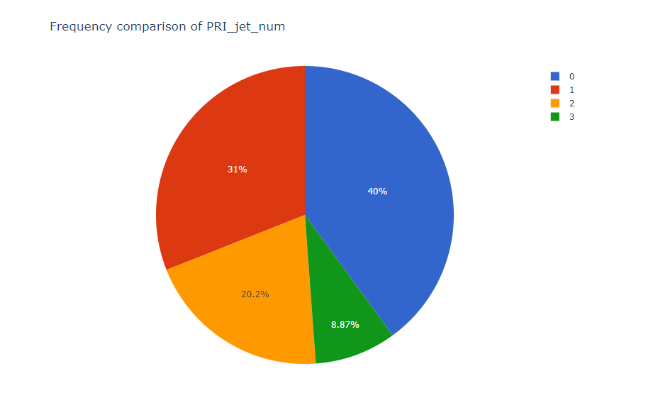

Slide 27
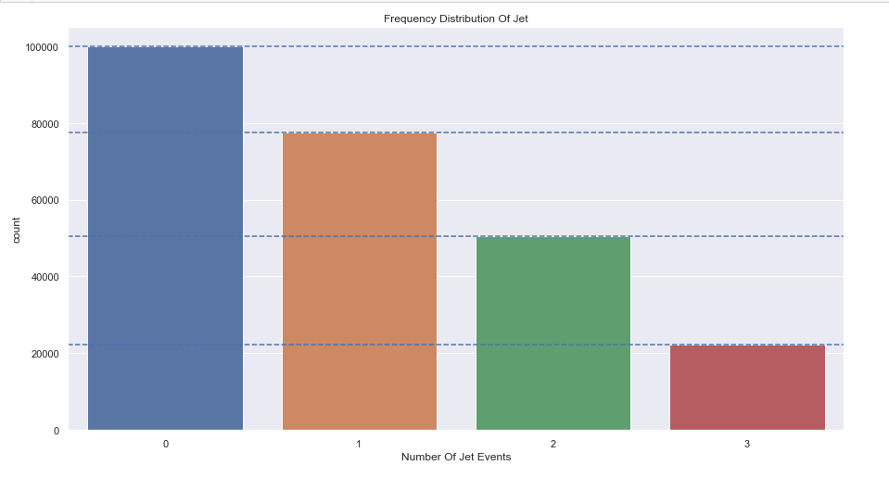

Slide 28
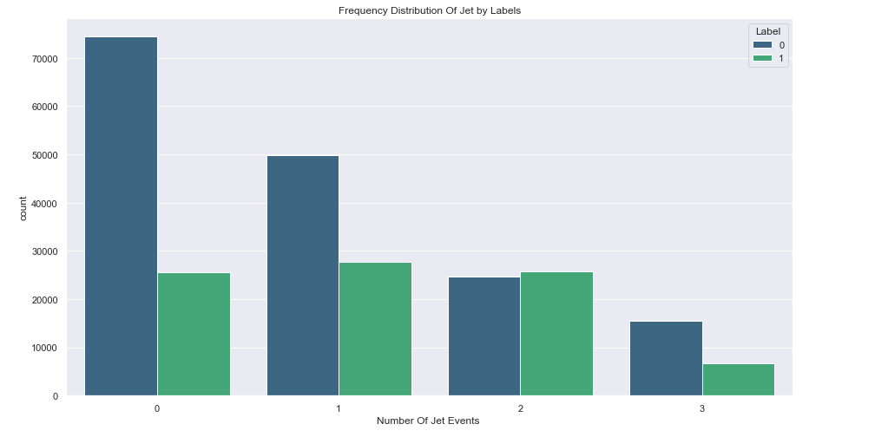

Slide 29
2. Multivariate Analysis
Correlation structure of float features
Bivariate scatterplots

Slide 30
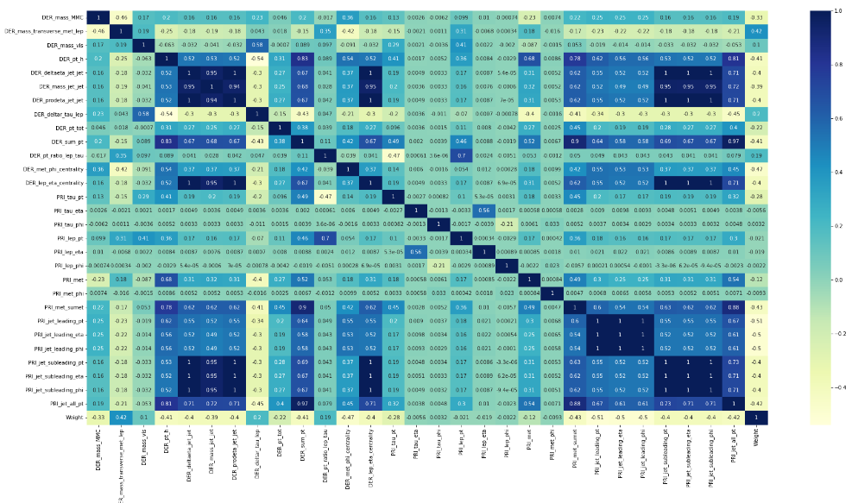
Correlation Structure of float features.

Slide 31
Observation: The following groups have shown extremely high positive correlation structure within themselves, i.e. any two features from a single group has extremely high correlation coefficient.
DER_deltaeta_jet_jet, DER_mass_jet_jet, DER_prodeta_jet_jet, DER_lep_eta_centrality, PRI_jet_subleading_pt, PRI_jet_subleading_eta, PRI_jet_subleading_phi
DER_sum_pt, PRI_met_sumet, PRI_jet_all_pt
PRI_jet_leading_pt, PRI_jet_leading_eta, PRI_jet_leading_phi

Slide 32
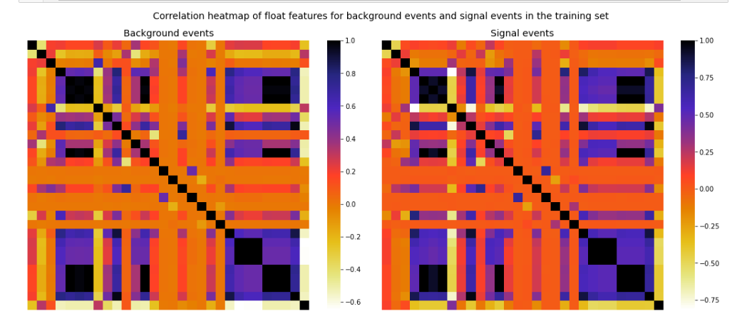
Observation: The two heatmaps are more or less similar, i.e. the overall correlation structure of the float features corresponding to the background events and the signal events in the dataset are very much alike

Slide 33
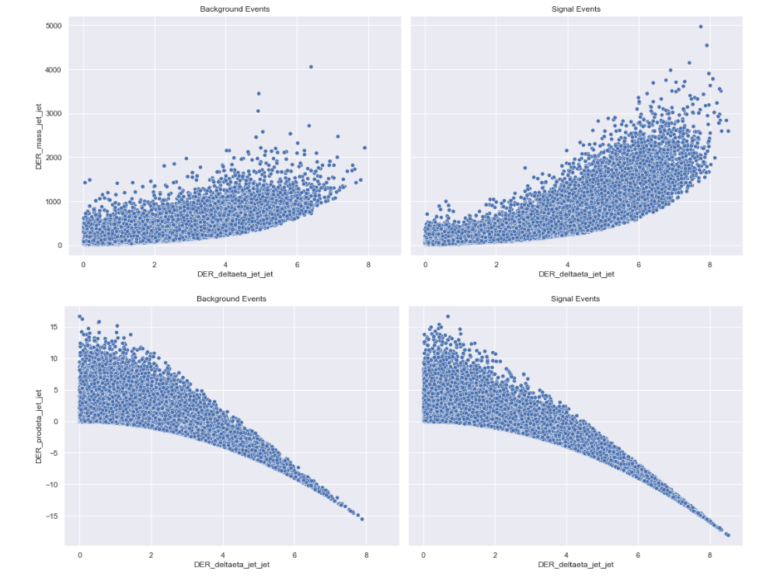

Slide 34
Data Preprocessing

Slide 35
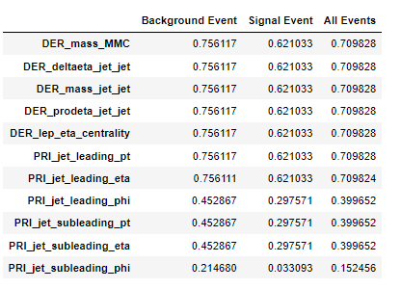
Handling Missing Values
We observed that many columns contains -999.000 values in large proportion.As per documentation of dataset,these variables are meaningless or cannot be computed,which is outside the normal range of all variables.
We suspect that these are the missing values which is fill with the constant value -999.000.So we are going to drop these columns from our dataset

Slide 36
Further we dropped the Weights columns as well.As mentioned in the research paper “The weights are an artifact of the way the simulation works and so they are not part of the input to the classifier. the weight distribution of the signal and background sets are very different and so they would give away the label immediately.”

Slide 37
Multicollinearity Problem
Further we analyze the correlation between the variables and found out multicollinearity problem in our data.So we keep one of these columns from each group and dropped the other columns.
DER_deltaeta_jet_jet, DER_mass_jet_jet, DER_prodeta_jet_jet, DER_lep_eta_centrality, PRI_jet_subleading_pt, PRI_jet_subleading_eta, PRI_jet_subleading_phi
DER_sum_pt, PRI_met_sumet, PRI_jet_all_pt
PRI_jet_leading_pt, PRI_jet_leading_eta, PRI_jet_leading_phi

Slide 38
Encoding
Integer column ‘PRI_JET_NUM’ has four unique values.So we performed One hot encoding as number of unique values are greater than 2.
We performed label encoding on ‘Label’ column(Target Variable) and convert it into numerical format.

Slide 39
Feature Engineering
We note the following observation from the analysis of skewness :
Columns with Extreme Positive skewness : ['DER_mass_MMC', 'DER_mass_vis', 'DER_pt_tot', 'PRI_tau_pt', 'PRI_lep_pt', 'PRI_met', 'PRI_jet_subleading_pt']
Column with High Positive Skewness : ['DER_mass_transverse_met_lep', 'DER_pt_h', 'DER_mass_jet_jet', 'DER_sum_pt', 'DER_pt_ratio_lep_tau', 'PRI_met_sumet', 'PRI_jet_leading_pt', 'PRI_jet_all_pt']
Column with Moderate Positive Skewness : ['DER_deltaeta_jet_jet', 'Weight']
To transform skewed data to approximately conform to normality. We used feature engineering technique to transform these features using yeo-johnson method.

Slide 40
Model Selection and Model Training

Slide 41
Train Test Split : We split the data in 80:20 ratio(the training set consists of 80% data and test consist of 20% of the data) We stratify the split using the labels,so that the proportion of each label remains roughly the same in the training set and test set.
Imbalance Data Treatment : We used SMOTE technique to deal with the imbalance data problem.
Machine Learning Models :
Logistic Regression
Random Forest Classifier
Decision Tree Classifier
Bagging Classifier
Gradient Boosting Classifier
Stacking Classifier.

Slide 42
Deep Learning Approach :
Artificial Neural Network Model for Classification Task
Model Evaluation Criteria : Accuracy Score,Precision,Recall,F1_Score,Roc_Auc_Score

Slide 43
Model Evaluation.

Slide 44
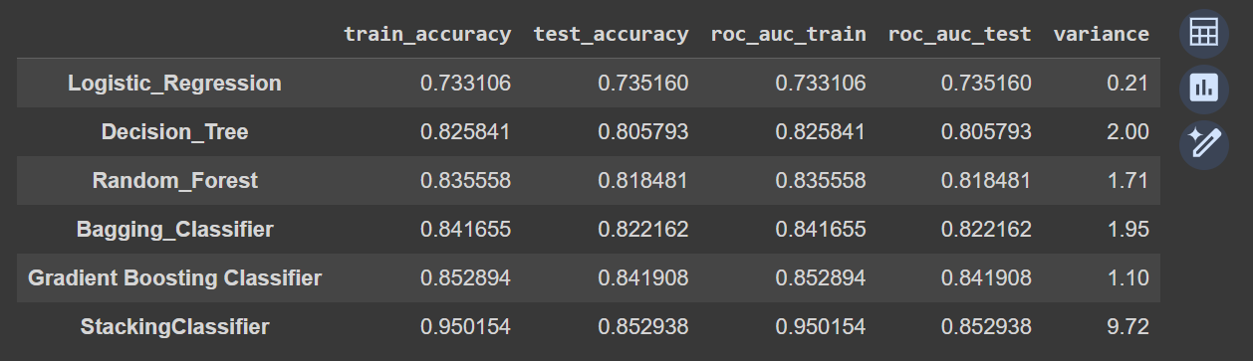
Performance of the Machine Learning models

Slide 45
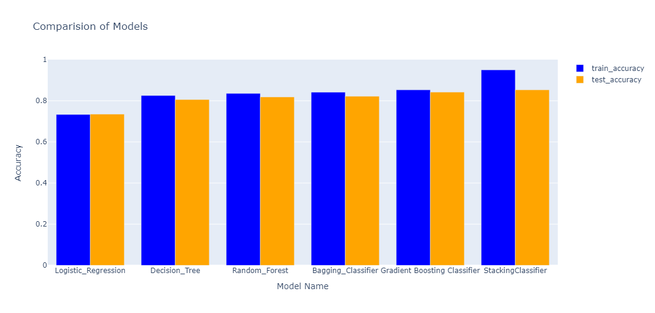

Slide 46
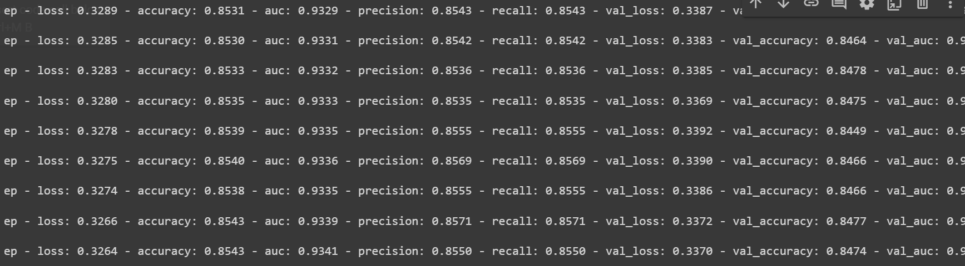
Performance of Deep Neural Network Model

Slide 47
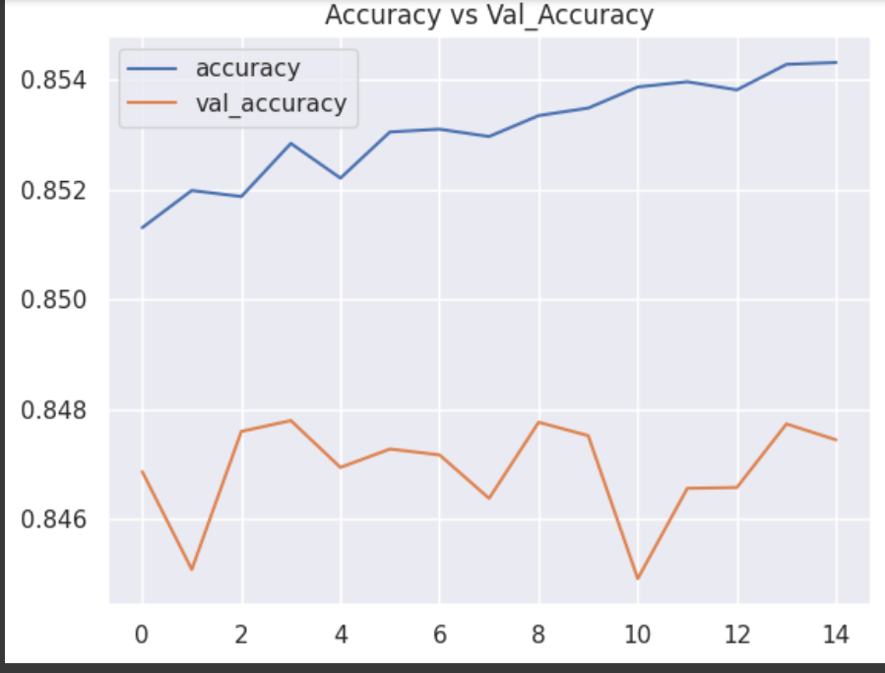

Slide 48
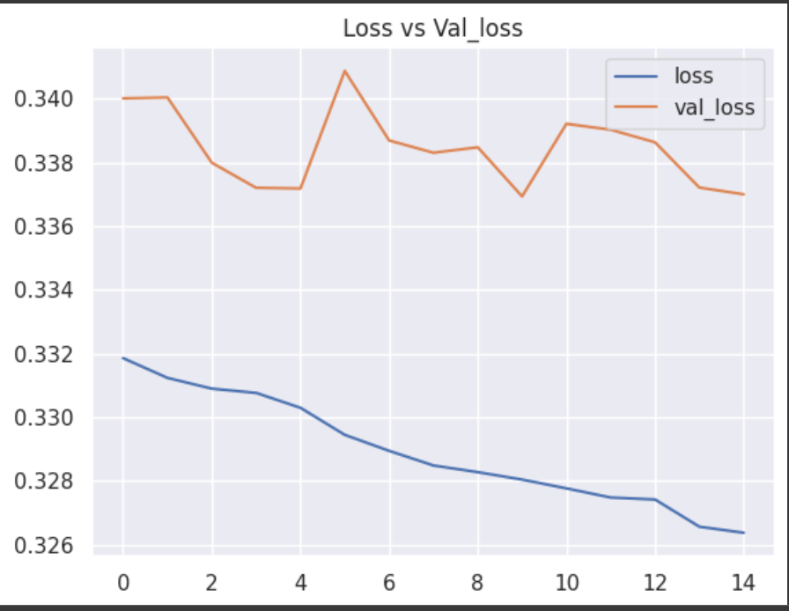

Slide 49
Conclusion.

Slide 50
1. All the models perform well and achieve accuracy above 80% both in training and testing except Logistic Regression Model.
2. Overall we can see the variance is mininum even less than 2 for all models except Stacking Classifier which has maximum Variance of 9.
3. Stacking Classifier is performing well on training set but performing moderate on test set with variance of 9.
4. With max_depth = 5 and n_estimators = 300 Gradient Boosting Classifier tend to be much more accurate than other models.
5. We Build the model using deep neural netowk with loss as Binary Cross Entropy and activation as relu and Sigmoid.We achieved the great train accuracy as 86% and test accuracy as 85%.
6. Hence We reached to the conclusion that Gradient Boosting Classifier and Deep Neural Network model is the best fit model for Particle Physics Event Detection Classification Problem.

Slide 51
References
Research Paper - https://higgsml.lal.in2p3.fr/files/2014/04/documentation_v1.8.pdf

Slide 52
Thank You

